Slide 1
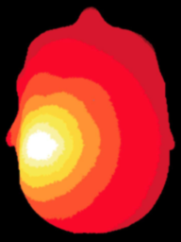
NeuroDOT
Tutorial:
Generating a Light Model

Slide 2
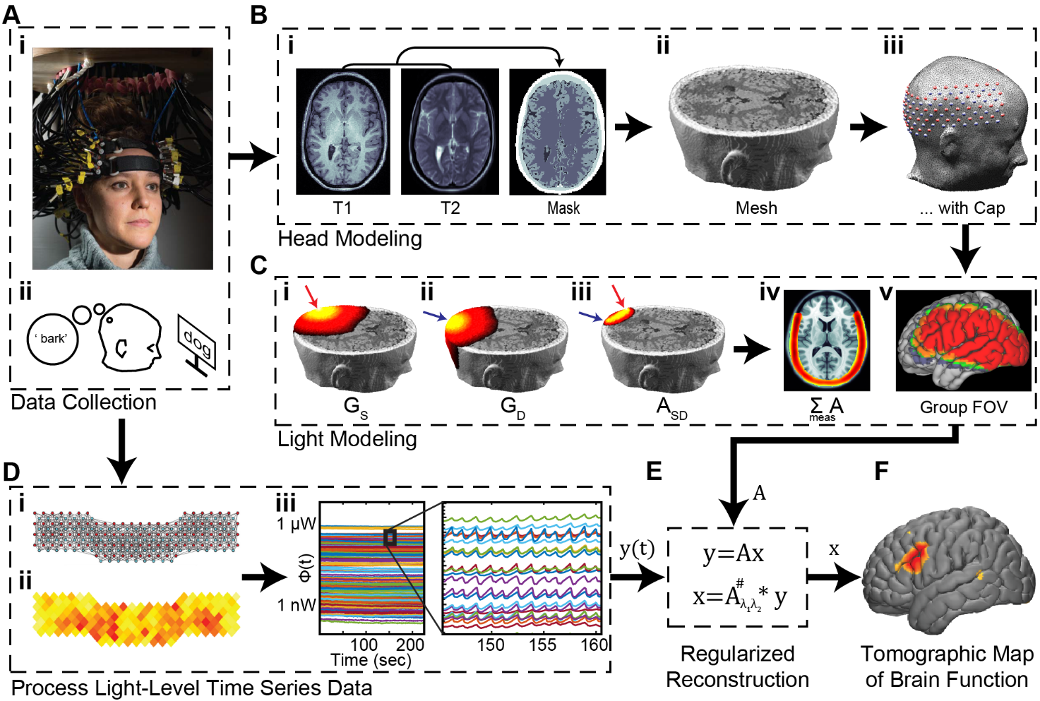
Diffuse Optical Tomography
In diffuse optical tomography (DOT), arrays of optical sources and detectors are used to perform functional neuroimaging experiments on task-based or resting state modes of human brain function.
Analyses are broken into several pipelines:
B: modeling of the tissue and optical geometry
C: modeling of the light emission, diffusion, and detection through the head
D: preprocessing of the raw source-detector measurements
E: reconstruction and spectroscopy of the preprocessed data and light model into a functional neuroimaging volume
F: post-processing analysis of these results.

Slide 3
Generating a Light Model
This tutorial will follow the Script_for_Basic_Head_Modeling.m Matlab file which can be found in the Documentation/Scripts folder.
The tutorial will:
Generate a mesh from a segmented volume
Place an array of sources and detectors on the mesh
Set multiple parameters for the model
Calculate the sensitivity A for this model
We will use a segmented volume, Segmented_MNI152nl_on_MNI111, found in Support_Files/Atlases, to generate the head model.
We will use the visual pad, Pad_AdultV24x28.mat, found in Support_Files/Pad.

Slide 4
NeuroDOT Flowchart for
Light Model Generation
MRI Acquisition
Image Segmentation
Mesh Generation
Optode Placement
Calculate Sensitivity
Validate Sensitivity

Slide 5
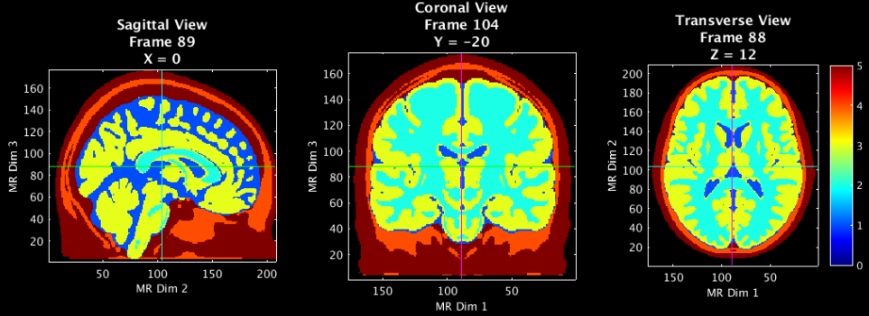
Load a Segmented volume and visualize
MRI Acquisition
[mask,infoT1]=LoadVolumetricData(['Segmented_MNI152nl_on_MNI111'],[],'4dfp');
p.Cmap='jet';p.Scale=5;p.Th.P=0;p.Th.N=-p.Th.P;p.PD=1;p.BG=[0,0,0];
PlotSlices(mask,infoT1,p) % Visualize the segmented mask
Image Segmentation
5 – Scalp
4 – Skull
3 – Gray Matter
2 – White Matter
1 – CSF
0 - Background

Slide 6
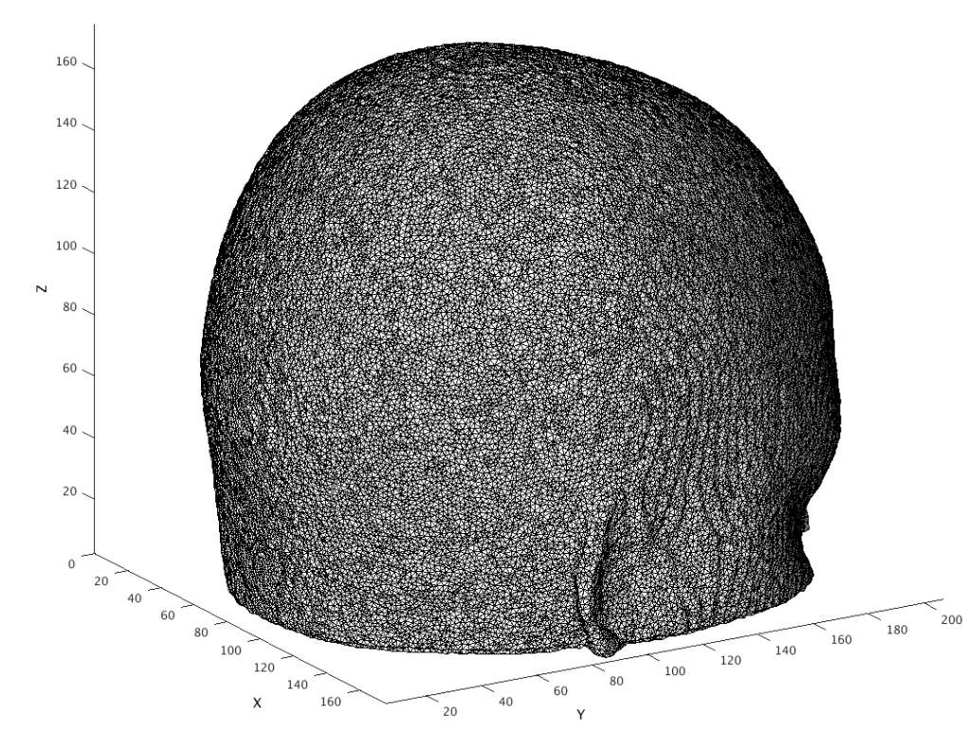
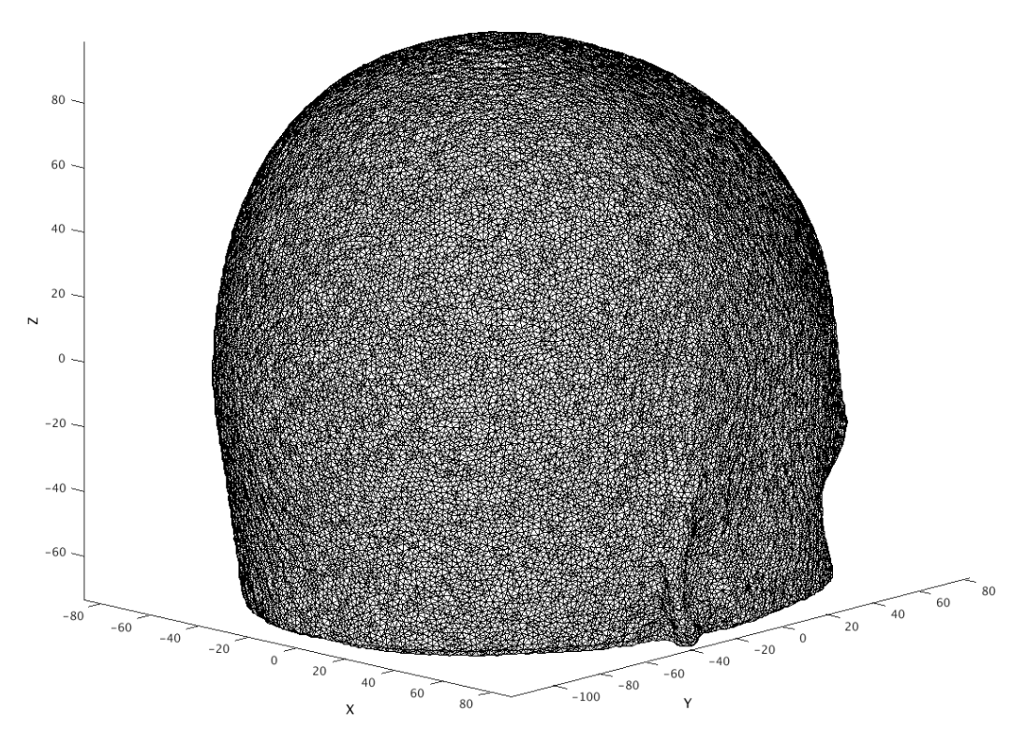
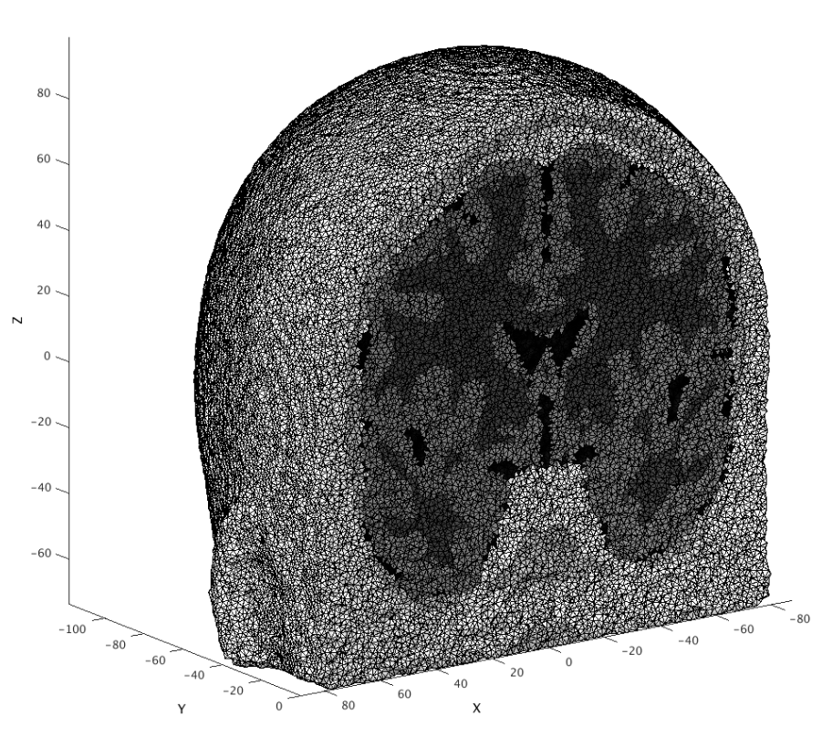
Generate a mesh and visualize
% Parameters for generating your mesh
meshname=['Example_Mesh']; % Provide a name for your mesh name here
param.facet_distance=0.75; % Node position error tolerance at boundary
param.facet_size =0.75; % boundary element size parameter
param.cell_size=1.4; % Volume element size parameter
param.info=infoT1;
param.Offset=[0,0,0];
param.r0=5; % nodes outside of mask must be set to scalp==5;
param.CheckMeshQuality=0;
param.Mode=0;
tic;mesh=NirfastMesh_Region_U87(mask,meshname,param);toc
MRI Acquisition
Image Segmentation
Mesh Generation
“index space”
is non-negative
“coordinate space”
Usually has zeros in center of volume
A view inside

Slide 7
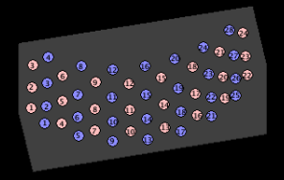
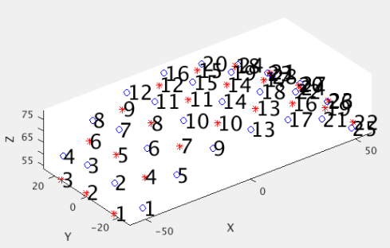
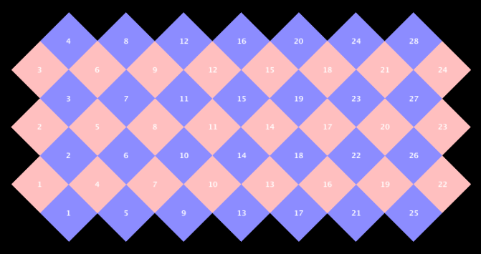
Place the optodes on the mesh (1 of 3)
Load in a Pad file for a grid design of interest, here the AdultV24x28 array.
padname='AdultV24x28';
load(['Pad_',padname,'.mat']); % Pad file
tpos=cat(1,info.optodes.spos3,info.optodes.dpos3);
Ns=size(info.optodes.spos3,1);
Nd=size(info.optodes.dpos3,1);
rad=info;
PlotSD(tpos(1:Ns,:),tpos((Ns+1):end,:),'norm');
PlotCap(info)
p.dimension=‘3D’;
PlotCap(info,p);
2. This Pad file is a starting point and may not align with the mesh right away.
2a. See Appendix below for details on making a Pad file for your array.
MRI Acquisition
Image Segmentation
Mesh Generation
Optode Placement

Slide 8
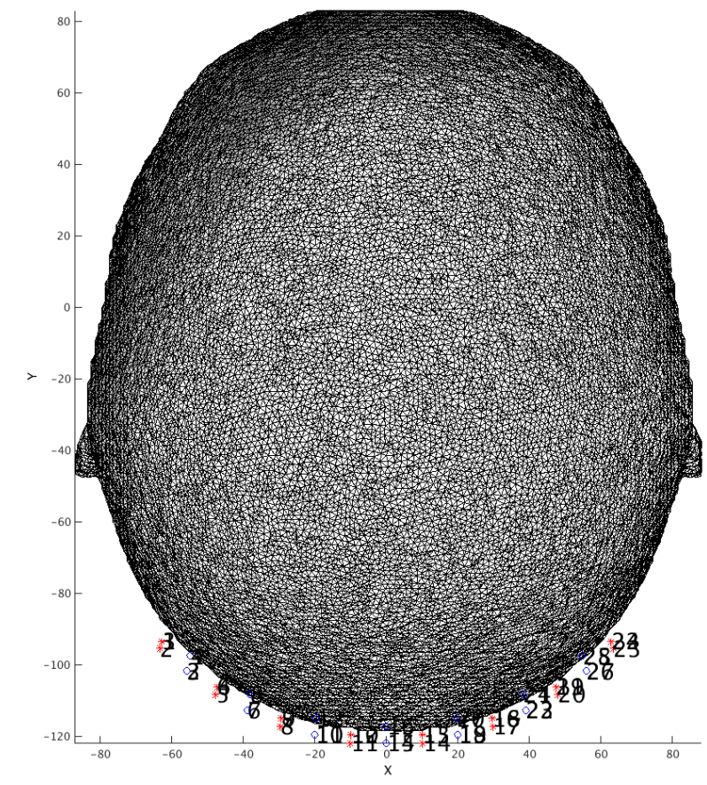
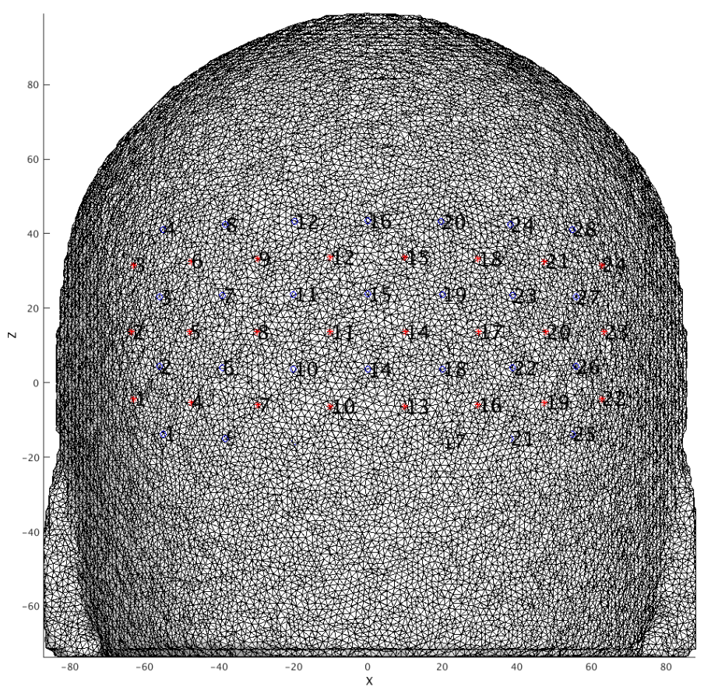
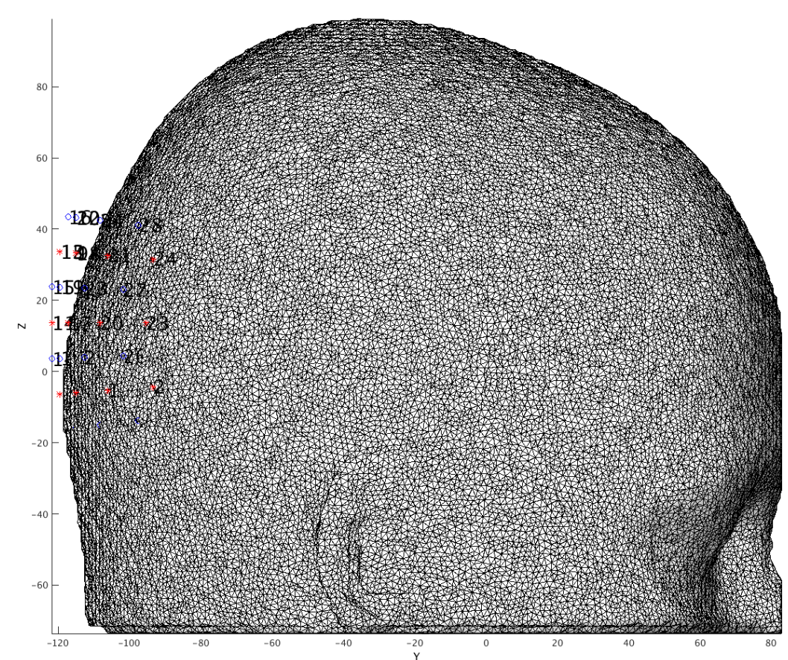
Place the optodes on the mesh (2 of 3)
Adjust array position by hand by altering parameters and re-visualizing mesh and array:
MRI Acquisition
tpos2=tpos;
dx=0;
dy=-110;
dz=-55;
dS=1.1;
dxTh=-90;
dyTh=0;
dzTh=0;
tpos2=rotate_cap(tpos2,[dxTh,dyTh,dzTh]);
tpos2(:,1)=tpos2(:,1)+dx;
tpos2(:,2)=tpos2(:,2)+dy;
tpos2(:,3)=tpos2(:,3)+dz;
tpos2=scale_cap(tpos2,dS);
PlotMeshSurface(mesh,pM);PlotSD(tpos2(1:Ns,:),tpos2((Ns+1):end,:),'norm',gcf);
Right-click to choose different views
Get the array close but not exactly on surface
Image Segmentation
Mesh Generation
Optode Placement

Slide 9
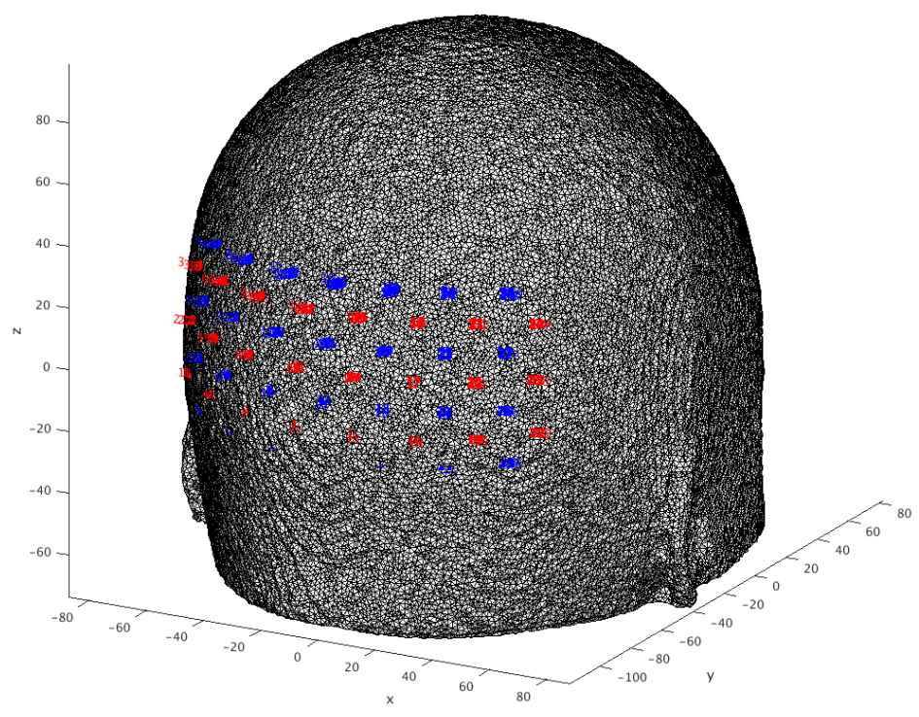
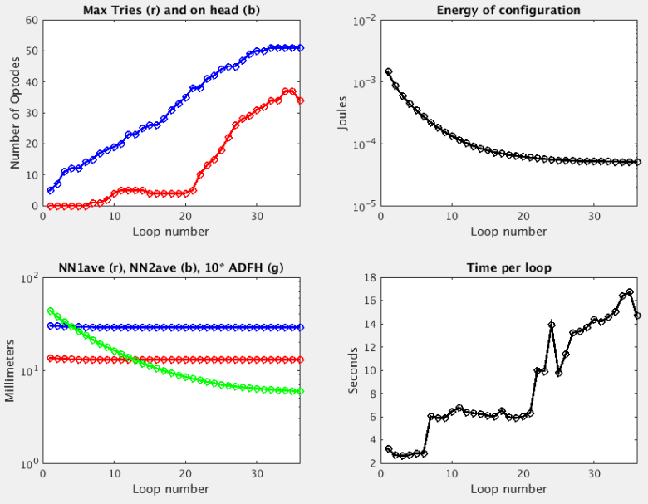
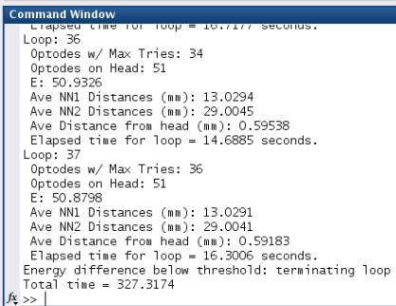
Place the optodes on the mesh (3 of 3)
4. Relax the grid on the head using the spring energy minimization algorithm
MRI Acquisition
%% Relax grid on head
m0.nodes=mesh.nodes;
m0.elements=mesh.elements;
spos3=tpos2(1:Ns,:);
dpos3=tpos2((Ns+1):end,:);
tposNew=gridspringfit_ND2(m0,rad,spos3,dpos3);
save(['Pad_',padname,'_on_',meshname,'.mat'],'info'); % New Specific Pad file
Image Segmentation
Mesh Generation
Optode Placement

Slide 10
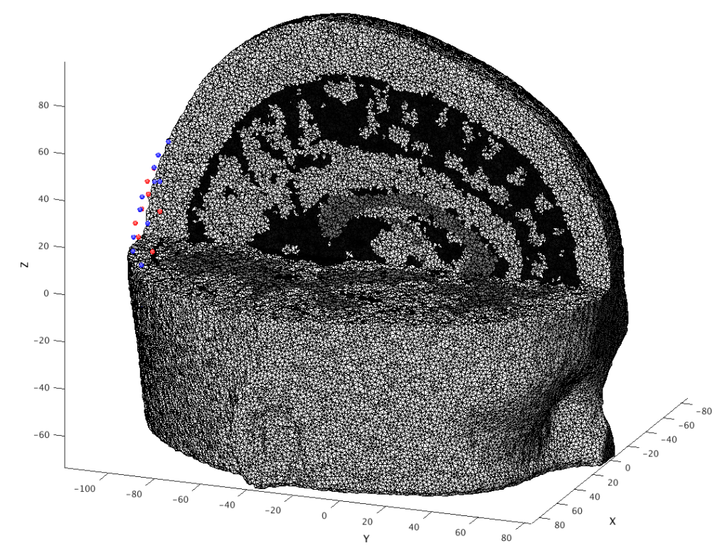
Calculate the sensitivity (1 of 3)
Prepare mesh and optode information for NIRFAST
gridname=padname;
mesh=PrepareMeshForNIRFAST(mesh,[meshname,'_',gridname],tposNew);
PlotMeshSurface(mesh,pM);PlotSD(mesh.source.coord(1:Ns,:),...
mesh.source.coord((Ns+1):end,:),'render',gcf);
Visualize cap and mesh to make extra sure you like the placement
MRI Acquisition
Image Segmentation
Mesh Generation
m3=CutMesh(mesh,intersect(find(mesh.nodes(:,3)>0),find(mesh.nodes(:,1)>0)));
[Ia,Ib]=ismember(m3.nodes,mesh.nodes,'rows');Ib(Ib==0)=[];
m3.region=mesh.region(Ib);
PlotMeshSurface(m3,pM);PlotSD(mesh.source.coord(1:Ns,:),...
mesh.source.coord((1+Ns):end,:),'render',gcf);
Optode Placement
Calculate Sensitivity

Slide 11
Calculate the sensitivity (2 of 3)
3. Set parameters for light modeling
flags.tag=[padname,'_on_',meshname,’_test’];
flags.gridname=gridname;
flags.meshname=meshname;
flags.head='info';
flags.info=infoT1; % Your T1 info file
flags.gthresh=1e-3; % Voxelation threshold in G
flags.voxmm=2; % Voxelation resolution (mm)
flags.labels.r1='csf'; % Regions for optical properties
flags.labels.r2='white';
flags.labels.r3='gray';
flags.labels.r4='bone';
flags.labels.r5='skin';
flags.op.lambda=[750,850]; % Wavelengths (nm)
flags.op.mua_skin=[0.0170,0.0190]; % Baseline absorption
flags.op.mua_bone=[0.0116,0.0139];
flags.op.mua_csf=[0.0040,0.0040];
flags.op.mua_gray=[0.0180,0.0192];
flags.op.mua_white=[0.0167,0.0208];
flags.op.musp_skin=[0.74,0.64]; % Baseline reduced scattering coeff
flags.op.musp_bone=[0.94,0.84];
flags.op.musp_csf=[0.3,0.3];
flags.op.musp_gray=[0.8359,0.6726];
flags.op.musp_white=[1.1908,1.0107];
flags.op.n_skin=[1.4,1.4]; % Index of refration
flags.op.n_bone=[1.4,1.4];
flags.op.n_csf=[1.4,1.4];
flags.op.n_gray=[1.4,1.4];
flags.op.n_white=[1.4,1.4];
flags.srcnum=Ns; % Number of sources
flags.t4=eye(4); % T1/dim to MNI atlas
flags.t4_target='MNI'; % string
flags.makeA=1; % if 0, don't make A, just make G
flags.Hz=0;
if flags.Hz, flags.tag = [flags.tag,'FD']; end
MRI Acquisition
Image Segmentation
Mesh Generation
Optode Placement
Calculate Sensitivity

Slide 12
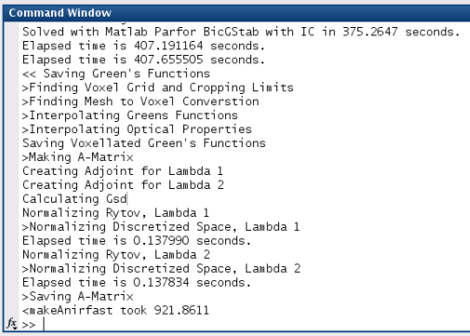
Calculate the sensitivity (3 of 3)
4. Calculate Green’s functions, voxelate, create sensitivity matrix, adjust bookkeeping.
Ti=tic;[A,dim]=makeAnirfast(mesh,flags); % size(A)= [Nwl, Nmeas, Nvox]
disp(['<makeAnirfast took ',num2str(toc(Ti))])
info.tissue.dim=dim;
info.tissue.affine=flags.t4;
info.tissue.infoT1=infoT1;
info.tissue.affine_target='MNI';
If successful, info like the below should show up in your command window:
MRI Acquisition
Image Segmentation
Mesh Generation
Optode Placement
Calculate Sensitivity

Slide 13
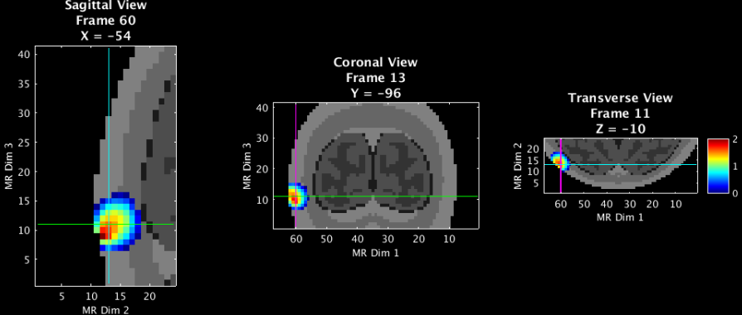
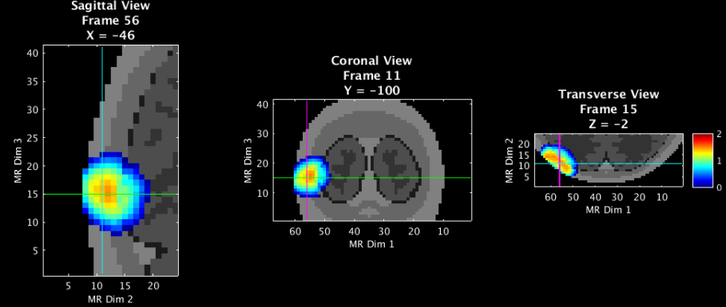
Validate the sensitivity (1 of 2)
Visualize an example measurement’s sensitivity
% Visualize aspects of sensitivity profile
t1=affine3d_img(mask,infoT1,dim,eye(4)); % put anatomical volume in dim space
keep=info.pairs.WL==2 & info.pairs.Src==1 & info.pairs.Det==1; % A NN1 pair
foo=squeeze(A(2,keep,:)); % Single meas pair
fooV=Good_Vox2vol(foo,dim);
fooV=fooV./max(fooV(:));
fooV=log10(1e2.*fooV); % top 2 orders of magnitude.
pA.PD=1;pA.Scale=2;pA.Th.P=0;pA.Th.N=-pA.Th.P;
PlotSlices(t1,dim,pA,fooV)
MRI Acquisition
Image Segmentation
Mesh Generation
Optode Placement
NN1: source 1 detector 1
NN2: source 1 detector 6
Calculate Sensitivity
Validate Sensitivity

Slide 14
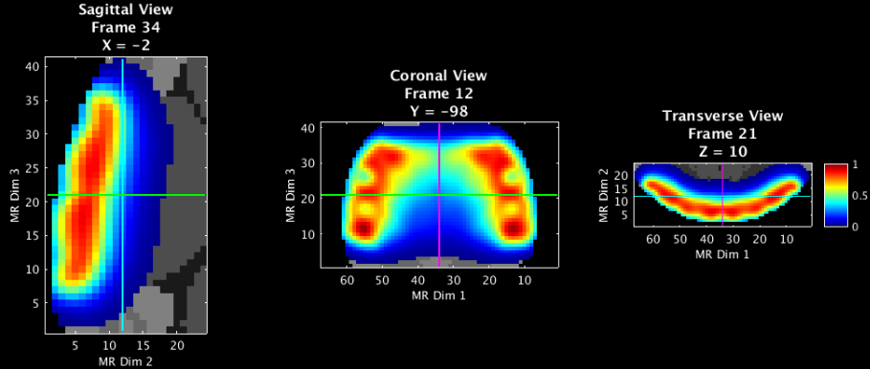
Validate the sensitivity (2 of 2)
Visualize the flat field reconstruction
keep=(info.pairs.WL==2 & info.pairs.r2d<=40);
keep(info.pairs.WL==1)=[];
a=squeeze(A(2,keep,:));
iA=Tikhonov_invert_Amat(a,0.01,0.1);
iA=smooth_Amat(iA,dim,3);
ffr=makeFlatFieldRecon(a,iA);
fooV=Good_Vox2vol(ffr,dim);
fooV=fooV./max(fooV(:));
pA.PD=1;pA.Scale=1;pA.Th.P=1e-2;pA.Th.N=-pA.Th.P;
PlotSlices(t1,dim,pA,fooV)
MRI Acquisition
Image Segmentation
Mesh Generation
Optode Placement
Calculate Sensitivity
Validate Sensitivity

Slide 15
Appendix: Generating info for Pad file (1 of 3)
The Pad file for a given grid design contains a structure variable info that contains the spatial and topological information for the array as follows:
info.optodes
Structure containing spatial coordinates for sources and detectors in array
info.optodes.spos2 – 2D coordinates of each sources
info.optodes.spos3 – 3D coordinates of each source
info.optodes.dpos2 – 2D coordinates of each detector
info.optodes.dpos3 – 3D coordinates of each detector
info.pairs
Table containing topological information for each source-detector measurement pair
Each row of this table corresponds to a measurement and must be in the same order as the optical data for valid processing
Generally, full list of sources and detectors is repeated for each wavelength/lambda.
info.pairs.Src – source in measurement
info.pairs.Det – detector in measurement
info.pairs.NN – Nearest Neighbor class in array (e.g., info.pairs.NN=1 means this measurement is one of the closest in the grid design)
info.pairs.WL – wavelength index of measurement
info.pairs.lambda – actual wavelength of measurement (e.g., info.pairs.lambda-=750 is a 750 nm measurement)
info.pairs.Mod – Modulation type of measurement (e.g., ‘CW’, or, ‘FD’)
info.pairs.r2d – 2D source-detector distances
info.pairs.r3d – 3D source-detector distances

Slide 16
Appendix: Generating info for Pad file (2 of 3)
If you already have a grid design with 2D and 3D source and detector locations, saved as the following:
grid.spos2
grid.spos3
grid.dpos2
grid.dpos3
To generate the topology structure for your grid:
dr=5; % Distance separating 'nearest neighbor' groups
Rad=Grid2Radius_180824(grid,dr);
Once you have the grid and radius set up (as above), the info structure can be generated with the following:
grid.name='Your_Grid_Name';
params.lambda=[750,850]; % Wavelengths for your system
params.Mod='CW'; % Modulation strategy
[info]=Generate_Info_from_Grid_Rad(grid,Rad,params);
Then just save the Pad file for future use:
save(['Pad_',info.optodes.CapName],'info')

Slide 17
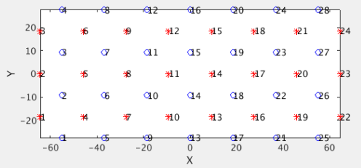
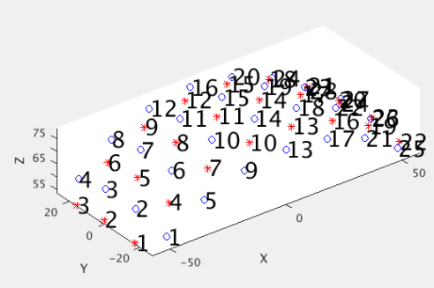
Appendix: Generating info for Pad file (3 of 3)
If instead you are designing a grid from scratch in style of our visual cap:
Ndy=4; % Num detectors in y-direction
Ndx=7; % Num detectors in x-direction
NN1sep=13; % Closest source-detector Separation
Srad=80; % Radius of spherical head model
[grid,Rad]=Make_Sphere_Cap(Ndy,Ndx,NN1sep,Srad);
As described above,
grid contains information on the positions of the sources and detectors.
Rad contains information on the topology of the array.
Visualize the grid in 2D and 3D
PlotSD(grid.spos2,grid.dpos2,'norm'); % Visualize 2D positions
PlotSD(grid.spos3,grid.dpos3,'norm'); % Visualize 3D positions
Then set parameters, generate info file as on previous slide, and save Pad file for future use.

Slide 18
That’s It (For Now)
Congratulations! You have finished the NeuroDOT Light Modeling Pipeline Tutorial.
For further questions or more information, please consult the NeuroDOT User Manual and the various Appendices.
NeuroDOT Team:
Adam Eggebrecht (aeggebre@wustl.edu)
Jason Trobaugh (jasont@wustl.edu)

